Slide 1


SKILL
UP
Online Learning Platform web based Application

Slide 2
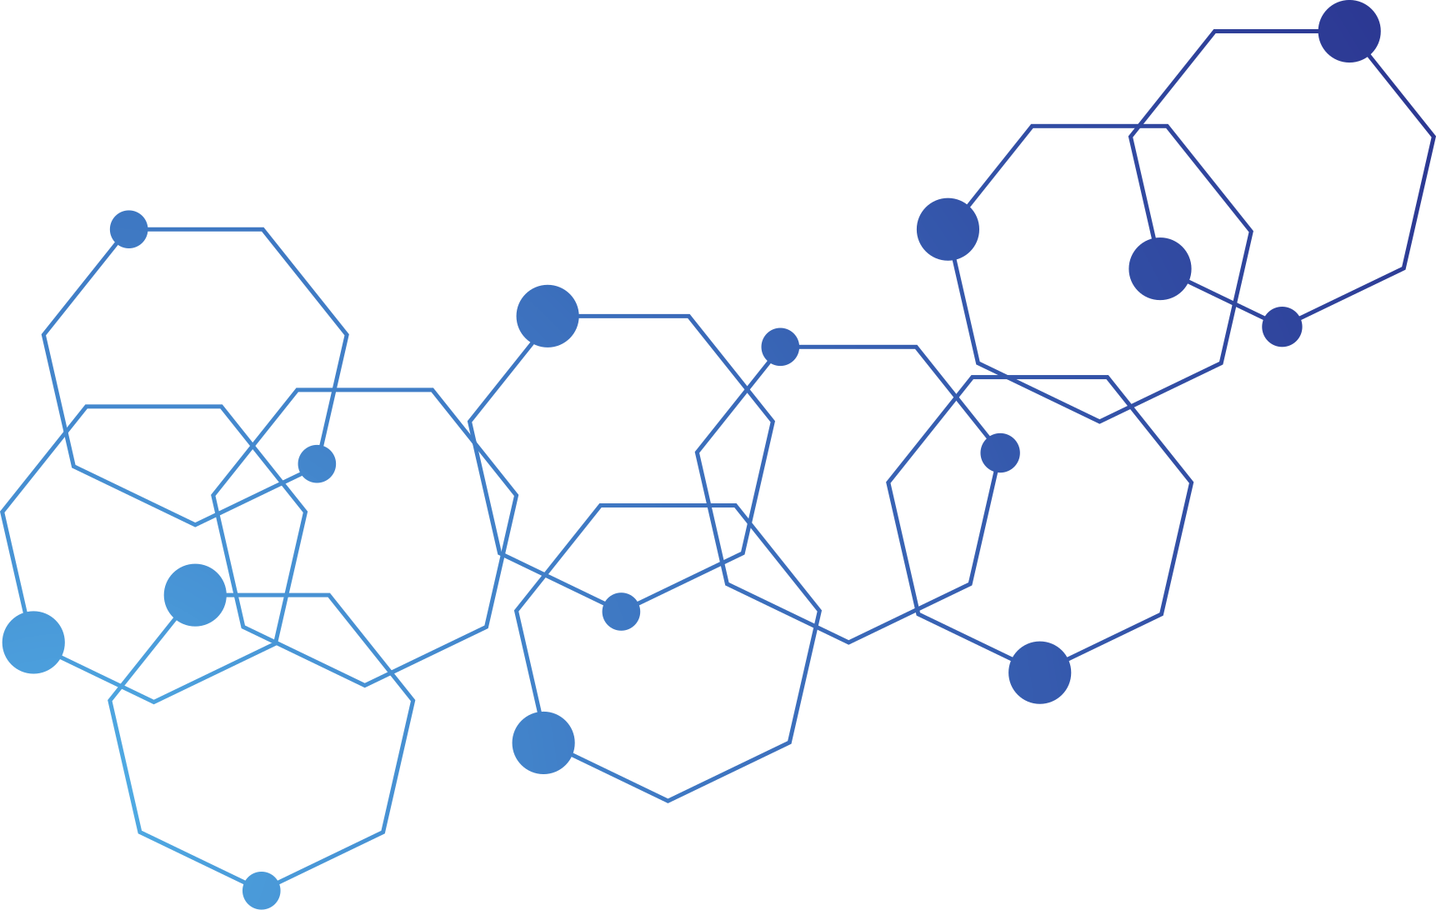

Team members
Taghreed Samir Mohammed
Rawan Mohamed Qandil
Mohammed Abbas Mohammed
Ahmed Kamel Abdel-Gaber
Mahmoud Ahmed Mohamed
Ahmed Mohamed Elsayed
Supervisior
Eng.Karim Ali

Slide 3

Content List
Application Business Solution
Database Design
Software Architecture
Application Users
Functional Requirements & Demo
Future Works

Slide 4


Application Business Solution

Slide 5
Problem :
Limitations of Offline Learning
Fixed Schedules
Higher Costs
geographical restrictions
Increasing Demand for Online Education
Necessitates a robust platform for managing courses
Solution Overview:
The proposed Online Learning Platform developed with ASP.NET Core addresses these needs by providing a user-friendly web application that enables effective course management, student enrollment, and progress tracking

Slide 6


Key Features
01
Course Management
Instructors and Admin can easily create, manage, and update courses, ensuring that content is current and relevant.
02
User Authentication
Secure login with role-based access for students, instructors, and administrators ensures privacy and data security
03
Course Enrollment
A simple and intuitive enrollment process allows students to join courses effortlessly, increasing participation rates
04
ProgressTracking
Students can monitor their learning progress, which enhances motivation and accountability

Slide 7
Key Features
05
User Profiles
Personalized profiles enable learners to track their enrolled courses and achievements, fostering a sense of ownership in their education
06
Search Functionality
Easy searching and filtering options help users find and select courses that match their interests and goals.
07
Responsive Design
A user-friendly interface ensures a seamless experience across various devices, making learning accessible anytime, anywhere

Slide 8

Database Design

Slide 9
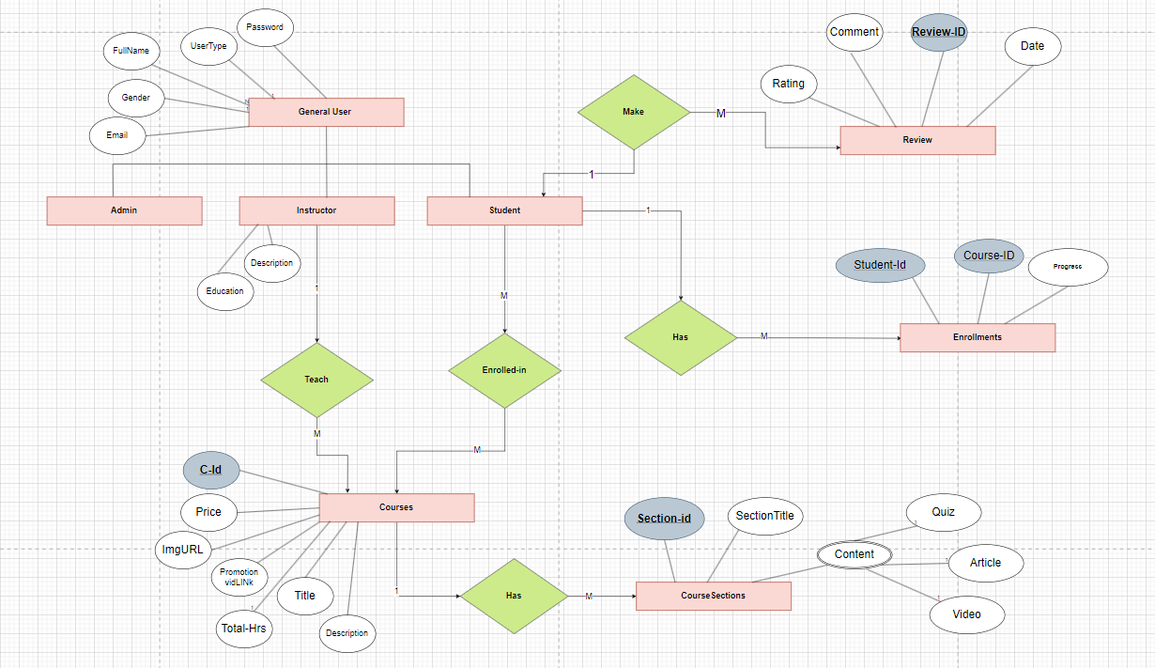
Entity Relationship Diagram
TPT inheritance
GeneralUser (Base class)
Student (Derived class)
Instructor (Derived class)
Admin (Derived class)

Slide 10
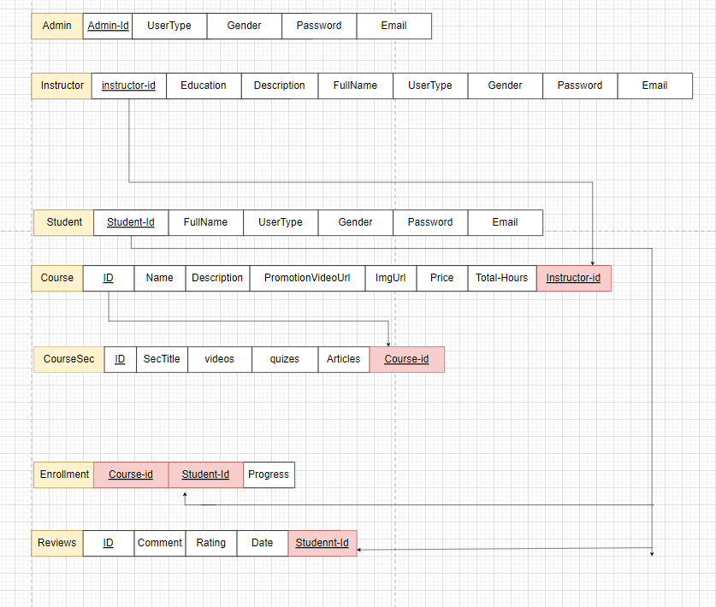
Mapping-ERD

Slide 11
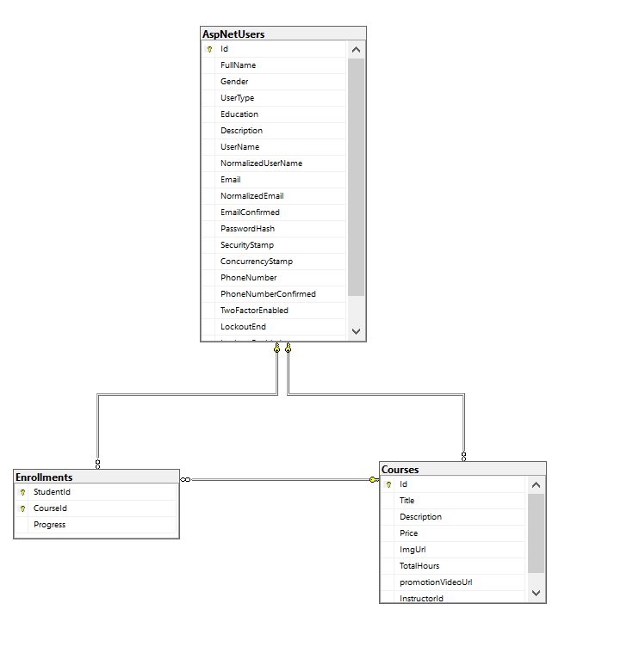
Actual tables which created

Slide 12

Software Architecture

Slide 13


N-teir Architicure
Entity Framwork
01
03
Technologies Used
02
04
Asp.Net Core MVC
Html,Css,JS

Slide 14
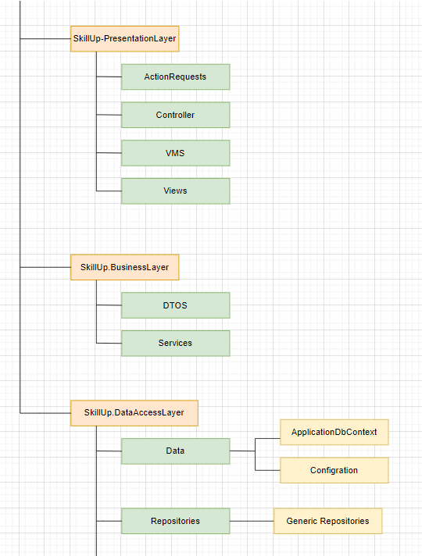


Main Structure
Also Used
Code First DB
Dependenciy Injection
Linq
Fluent API

Slide 15
Application Users

Slide 16
Application Users
Admin
Instructors
Students/Learners
admin Can Manage Courses By Show all Courses with basic info, Create, Edit and Delete Courses
can manage Users By show all users with basic info, Create user with role, Update and Delete Users
Instructors Can upload , Update and Delete Courses
Student Can Browse Courses, search and enroll in Courses
Track progress

Slide 17
Authentication
We have 3 type of Register Form one for Student, one for Instructor and one For Admin and single
Authentication Determines if a user is logged in or not. Unauthenticated users (guests) can only see limited information on the home page .
verifies a user’s identity through a single login form, ensuring the user is either an admin, instructor, or student. Upon successful login, the system identifies the user type and redirects them to the appropriate dashboard or homepage based on their role:
Admin → Admin Dashboard
Instructor → Instructor Dashboard
Student → Homepage → can view Details and Enroll in Course

Slide 18
Authorization
Role-Based Access:
Admin: Full system control.
Instructor: Manage personal courses.
3.Student: Access and enroll in courses.
Action Permissions:
Only authenticated students can enroll in courses

Slide 19
Functional Requirements

Slide 20
User Story For Students:
Student Register Then Login then redirect to homepage
view all courses
Search For Course
view details of course
enroll in Course
profile page to view details and enrolled courses
User Story For Admin:
Admin Register Then Login then redirect to Admin dashboard
Manage Users (update-Delete-Add)
Mange Courses (update-Delete-Add)
User Story For Instructors:
Instructor Register Then Login then redirect to Instructors dashboard

Slide 21
Future Works

Slide 22
Future works
Add progress bar and Handle Progress Tracking System requirement
work on instructor dashboard
Add more features Like rating and Receive certificate after finish course

Slide 23

THANK
YOU

